Slide 1
Chapter 8 Sorting in Linear Time
Chi-Yeh Chen
陳奇業
成功大學資訊工程學系

Slide 2
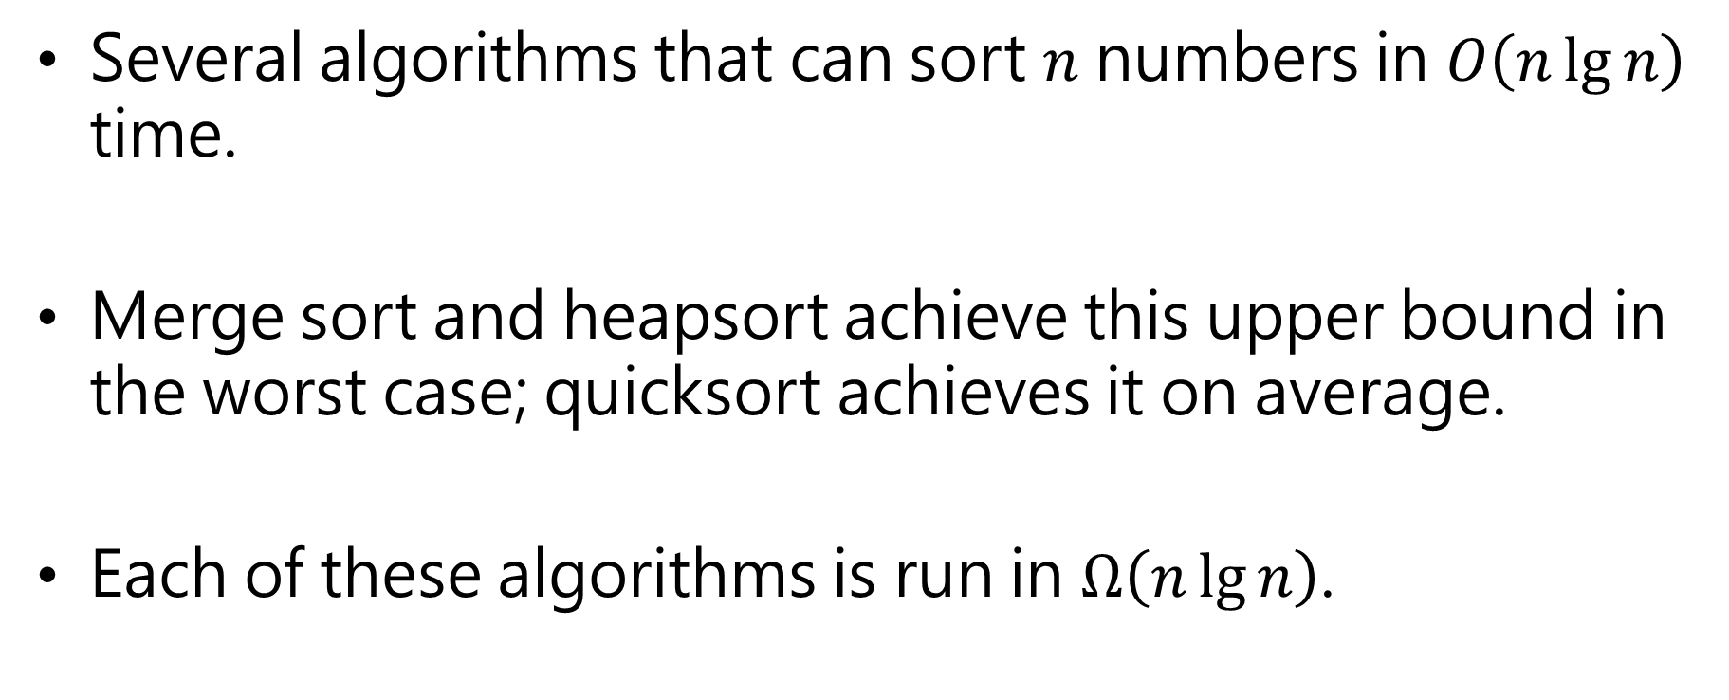
Overview
Several algorithms that can sort $n$ numbers in $O\left(n\lg{n}\right)$ time.
Merge sort and heapsort achieve this upper bound in the worst case; quicksort achieves it on average.
Each of these algorithms is run in $Ω\left(n\lg{n}\right)$.

Slide 3
Overview
These algorithms share an interesting property: the sorted order they determine is based only on comparisons between the input elements.
We call such sorting algorithms comparison sorts.

Slide 4
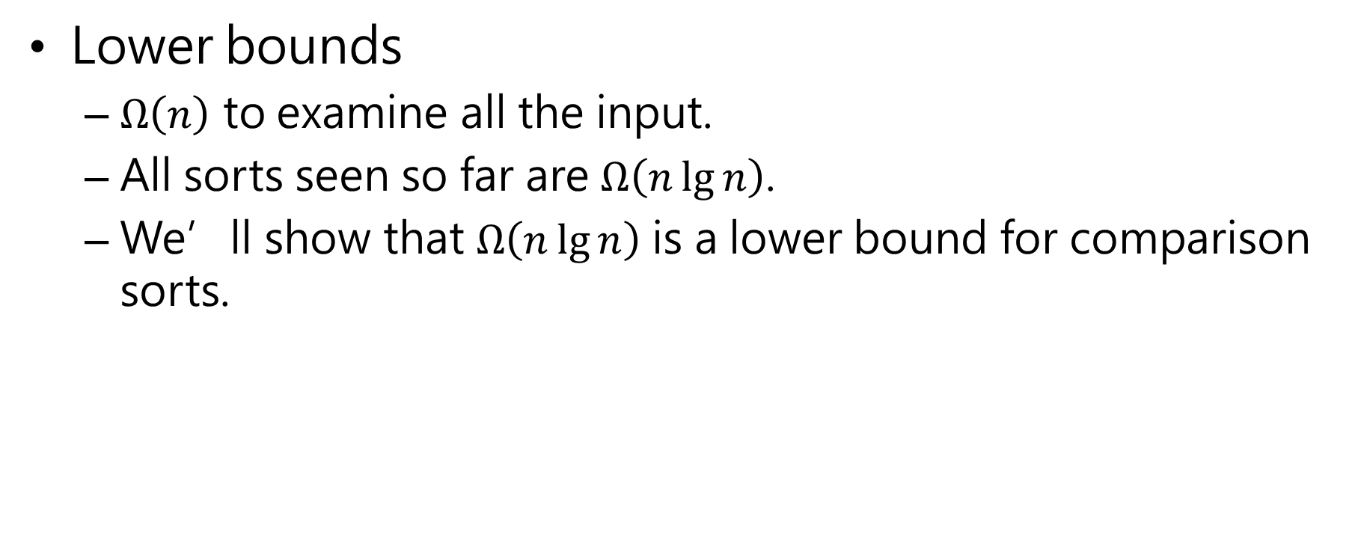
Lower bounds for sorting (comparison sorts)
Lower bounds
$Ω\left(n\right)$ to examine all the input.
All sorts seen so far are $Ω\left(n\lg{n}\right)$.
We’ll show that $Ω\left(n\lg{n}\right)$ is a lower bound for comparison sorts.

Slide 5
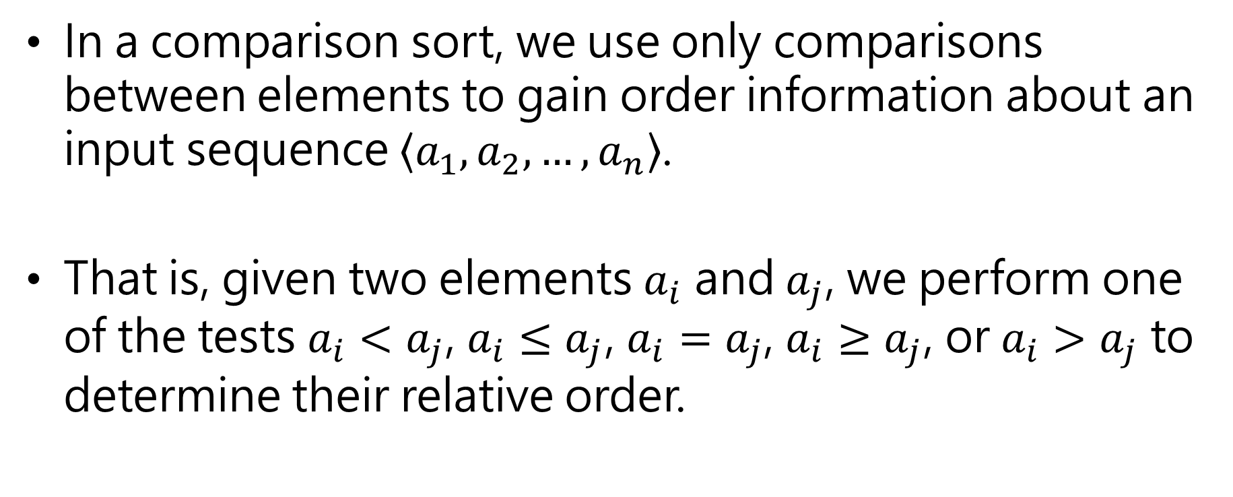
Lower bounds for sorting (comparison sorts)
In a comparison sort, we use only comparisons between elements to gain order information about an input sequence $\left\langle a_{1},a_{2}, …,a_{n}\right\rangle$.
That is, given two elements $a_{i}$ and $a_{j}$, we perform one of the tests $a_{i}<a_{j}$, $a_{i}≤a_{j}$, $a_{i}=a_{j}$, $a_{i}≥a_{j}$, or $a_{i}>a_{j}$ to determine their relative order.

Slide 6
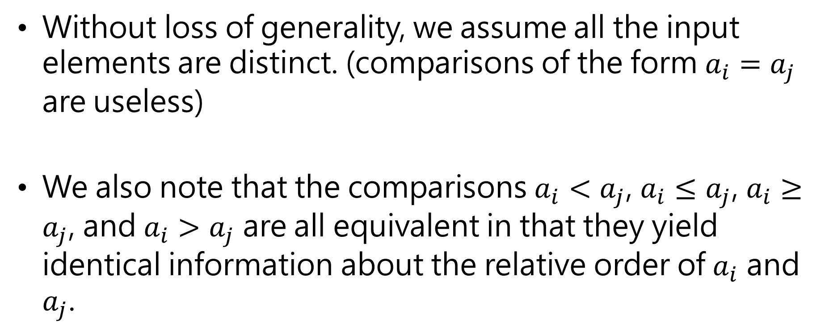
Lower bounds for sorting (comparison sorts)
Without loss of generality, we assume all the input elements are distinct. (comparisons of the form $a_{i}=a_{j}$ are useless)
We also note that the comparisons $a_{i}<a_{j}$, $a_{i}≤a_{j}$, $a_{i}≥a_{j}$, and $a_{i}>a_{j}$ are all equivalent in that they yield identical information about the relative order of $a_{i}$ and $a_{j}$.

Slide 7

Lower bounds for sorting (comparison sorts)
We therefore assume that all comparisons have the form $a_{i}≤a_{j}$.

Slide 8
The decision-tree model
We can view comparison sorts abstractly in terms of decision trees.
A decision tree is a full binary tree that represents the comparisons between elements that are performed by a particular sorting algorithm operating on an input of given size. (full binary tree: each node is either a leaf or has degree exactly 2)
Control, data movement, and all other aspects of the algorithm are ignored.

Slide 9
Decision tree
Abstraction of any comparison sort.
Represents comparisons made by
a specific sorting algorithm
on inputs of a given size.
Abstracts away everything else: control and data movement.
We’re counting only comparisons.

Slide 10
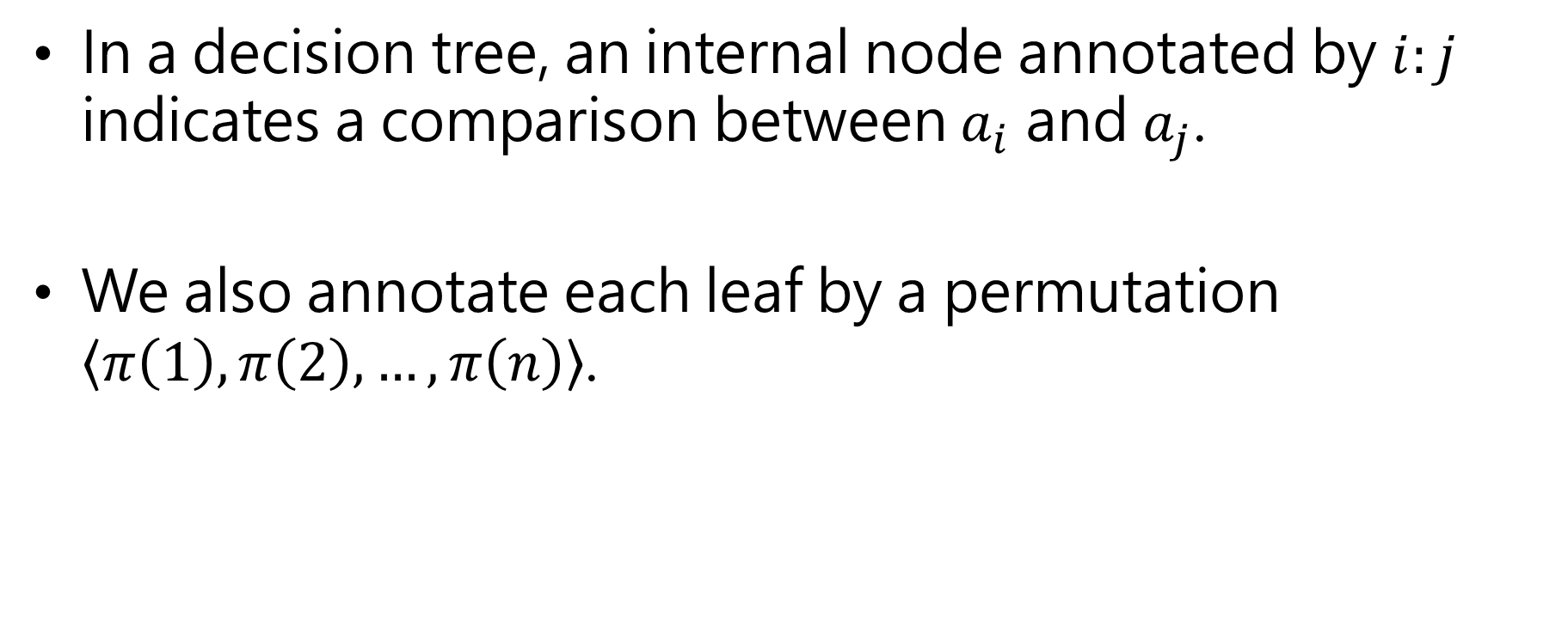
In a decision tree, an internal node annotated by $i:j$ indicates a comparison between $a_{i}$ and $a_{j}$.
We also annotate each leaf by a permutation $\left\langle π\left(1\right),π\left(2\right), …,π\left(n\right)\right\rangle$.

Slide 12




For insertion sort on 3 elements:
[Each internal node is labeled by indices of array elements from their original positions. Each leaf is labeled by the permutation of orders that the algorithm determines.]
compare A[1] ＞A[2]
A[1] ≦A[2]
1:2
A[1] ＞A[2] (swap in array)
≦
＞
2:3
A[1] ≦A[2]
A[2] ＞A[3]
1:3
A[1] ＞A[2]
A[1] ＞A[3]
≦
＞
≦
＞
<1,2,3>
1:3
<2,1,3>
2:3
≦
＞
≦
＞
A[1] ≦A[2] ≦A[3]
<1,3,2>
<3,1,2>
<2,3,1>
<3,2,1>

Slide 13
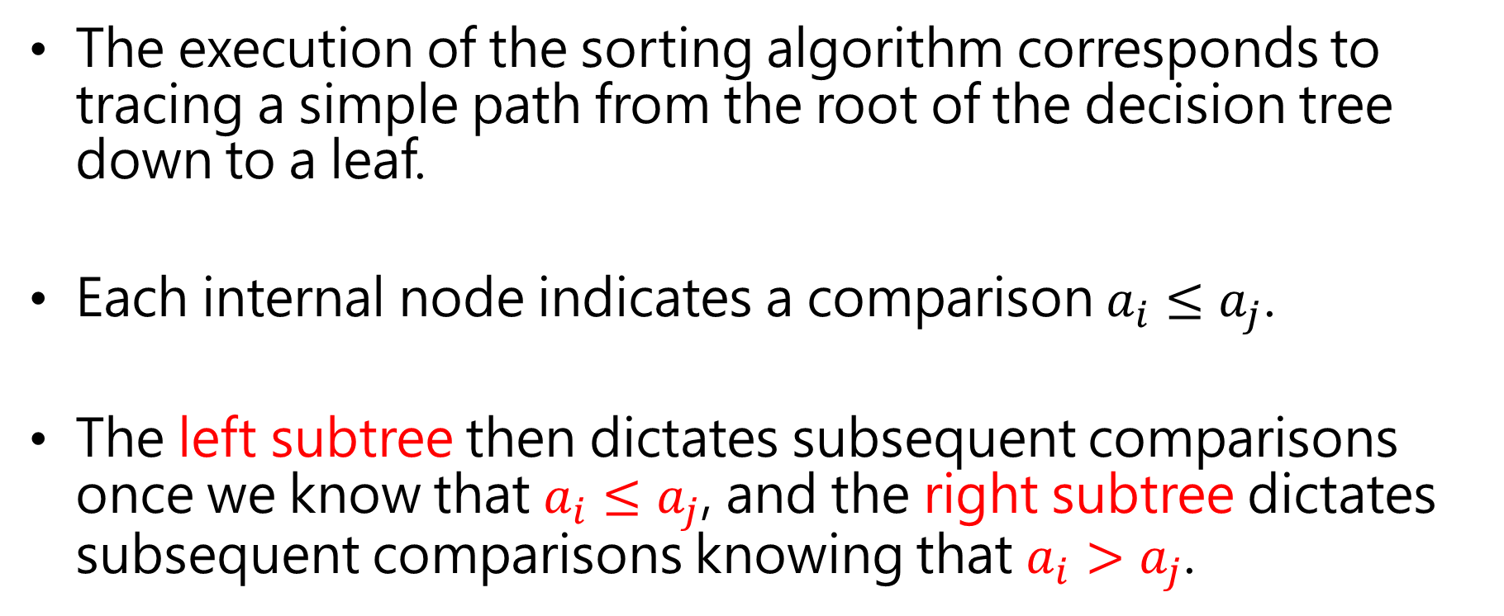
The execution of the sorting algorithm corresponds to tracing a simple path from the root of the decision tree down to a leaf.
Each internal node indicates a comparison $a_{i}≤a_{j}$.
The left subtree then dictates subsequent comparisons once we know that $a_{i}≤a_{j}$, and the right subtree dictates subsequent comparisons knowing that $a_{i}>a_{j}$.

Slide 14
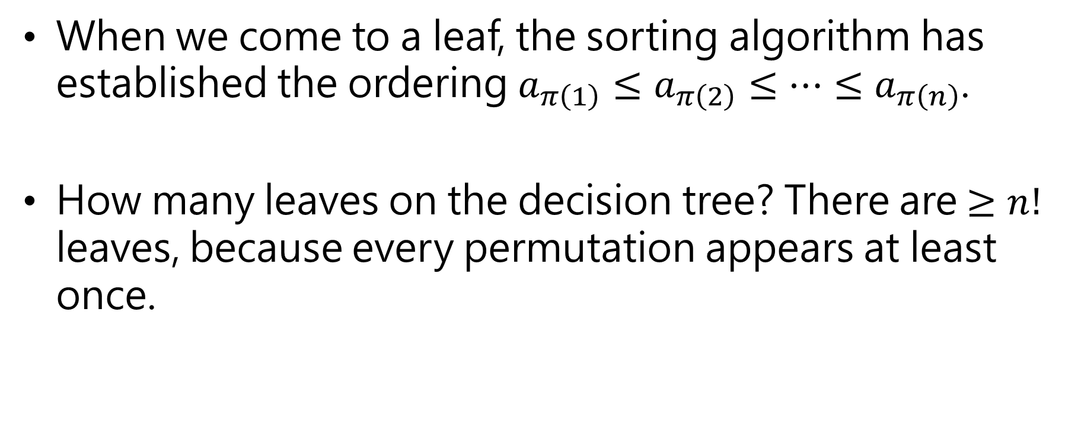
When we come to a leaf, the sorting algorithm has established the ordering $a_{π\left(1\right)}≤a_{π\left(2\right)}≤⋯≤a_{π\left(n\right)}$.
How many leaves on the decision tree? There are $≥n!$ leaves, because every permutation appears at least once.

Slide 15
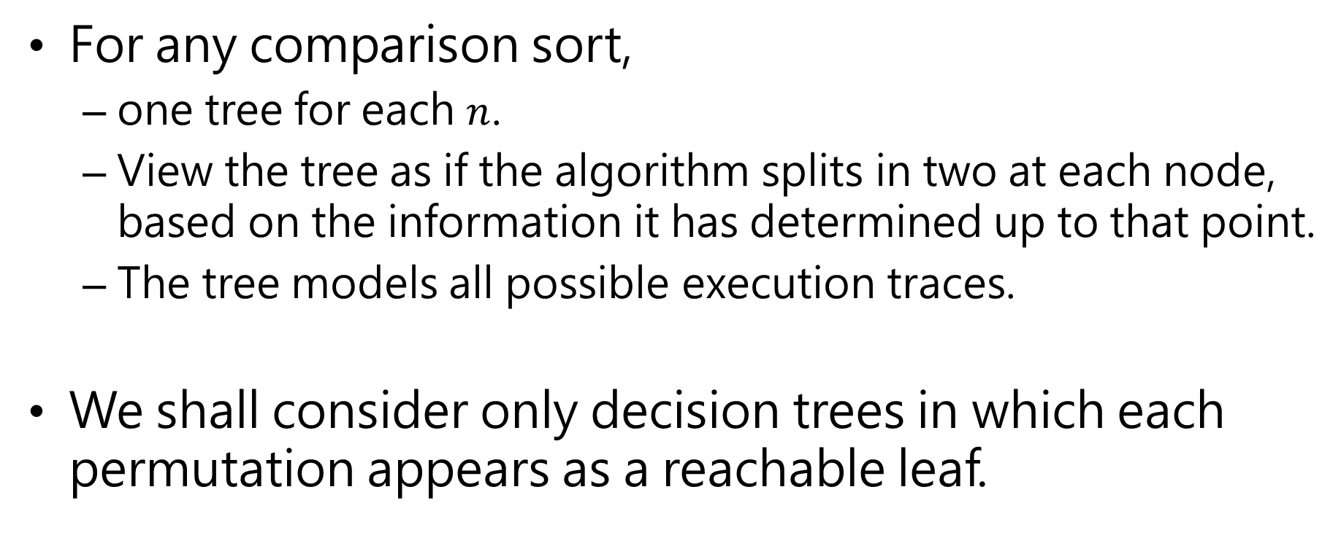
For any comparison sort,
one tree for each $n$.
View the tree as if the algorithm splits in two at each node, based on the information it has determined up to that point.
The tree models all possible execution traces.
We shall consider only decision trees in which each permutation appears as a reachable leaf.

Slide 16
A lower bound for the worst case
The length of the longest simple path from the root of a decision tree to any of its reachable leaves represents the worst-case number of comparisons that the corresponding sorting algorithm performs.
The worst-case number of comparisons for a given comparison sort algorithm equals the height of its decision tree.

Slide 17

What is the length of the longest path from root to leaf ?
Depends on the algorithm
Insertion sort: $Θ\left(n^{2}\right)$
Merge sort: $Θ\left(n\lg{n}\right)$

Slide 18
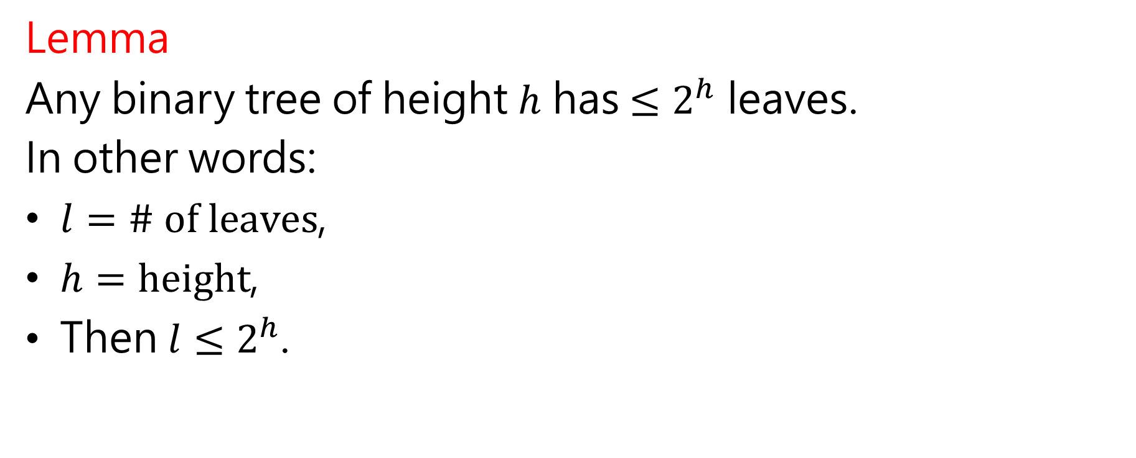
Lemma
Any binary tree of height $h$ has $≤2^{h}$ leaves.
In other words:
$l=\# of leaves$,
$h=height$,
Then $l≤2^{h}$.

Slide 19
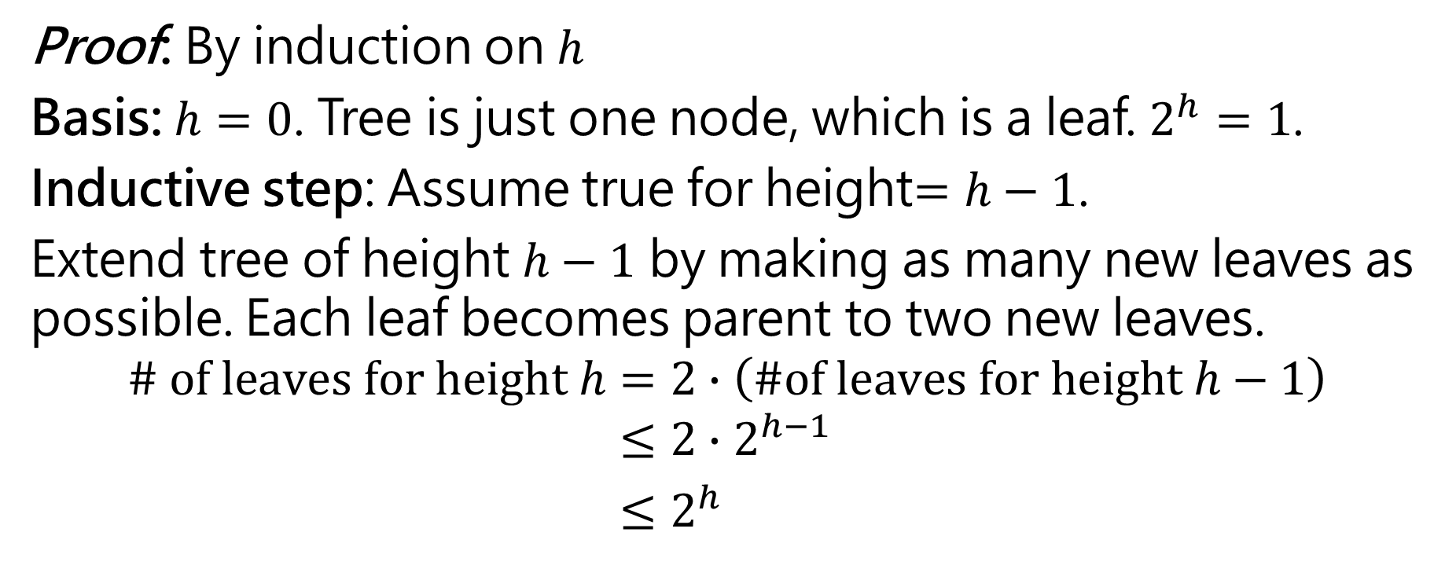
Proof: By induction on $h$
Basis: $h=0$. Tree is just one node, which is a leaf. $2^{h}=1$.
Inductive step: Assume true for height$=h−1$.
Extend tree of height $h−1$ by making as many new leaves as possible. Each leaf becomes parent to two new leaves.
$$\# of leaves for height h=2∙\left(\#of leaves for height h−1\right)$$
$$≤2∙2^{h−1}$$
$≤2^{h}$
(Inductive hypothesis)

Slide 20
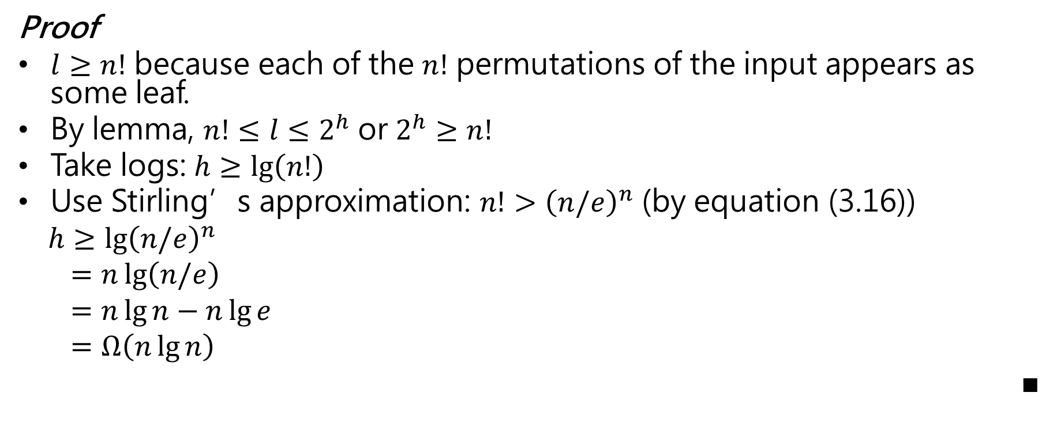


Theorem. Any decision tree that sorts $n$ elements has height $Ω\left(n\lg{n}\right)$
Proof
$l≥n!$ because each of the $n!$ permutations of the input appears as some leaf.
By lemma, $n!≤l≤2^{h}$ or $2^{h}≥n!$
Take logs: $h≥\lg\left(n!\right)$
Use Stirling’s approximation: $n!>{\left(n/e\right)}^{n}$ (by equation (3.16))
$h≥\lg{{\left(n/e\right)}^{n}}$
$=n\lg\left(n/e\right)$
$=n\lg{n}−n\lg{e}$
$=Ω\left(n\lg{n}\right)$
■
($e$ = Euler's number $≈$ 2.71828)

Slide 21

Theorem 8.1 Any comparison sort algorithm requires $Ω\left(n\lg{n}\right)$ comparisons in the worst case.

Slide 22
Corollary
Heapsort and merge sort are asymptotically optimal comparison sort.

Slide 23

The smallest possible depth of a leaf in a decision tree for a comparison sort is $n−1$
Ex. an already sorted array for insertion sort

Slide 24
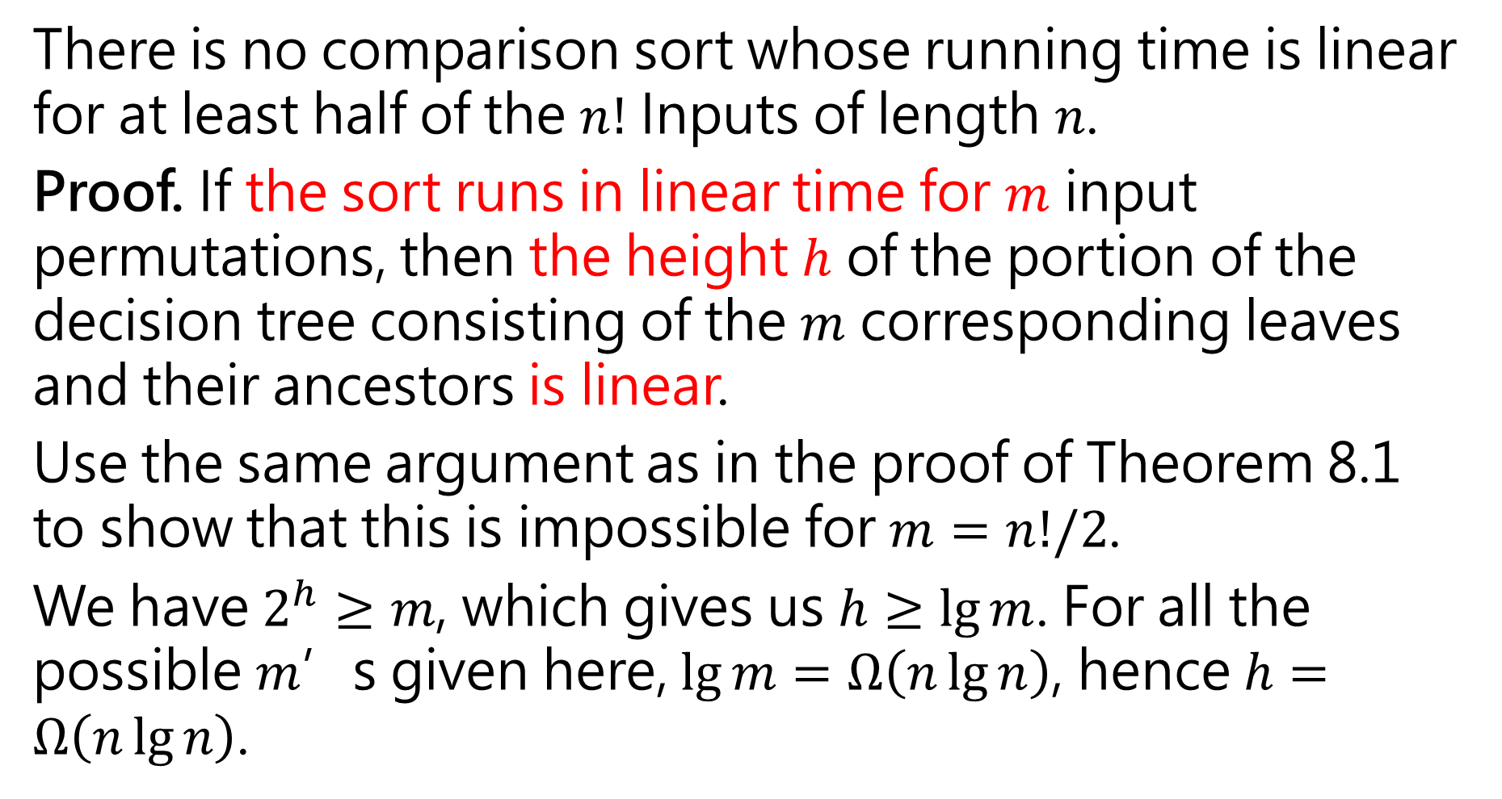
There is no comparison sort whose running time is linear for at least half of the $n!$ Inputs of length $n$.
Proof. If the sort runs in linear time for $m$ input permutations, then the height $h$ of the portion of the decision tree consisting of the $m$ corresponding leaves and their ancestors is linear.
Use the same argument as in the proof of Theorem 8.1 to show that this is impossible for $m=n!/2$.
We have $2^{h}≥m$, which gives us $h≥\lg{m}$. For all the possible $m$’s given here, $\lg{m}=Ω\left(n\lg{n}\right)$, hence $h=Ω\left(n\lg{n}\right)$.

Slide 25

In particular,
$$\lg{\frac{n!}{2}}=\lg{n!}−1≥n\lg{n}−n\lg{e}−1$$
Moreover,
$$\lg{\frac{n!}{n}}=\lg{n!}−\lg{n}≥n\lg{n}−n\lg{e}−\lg{n}$$
$$\lg{\frac{n!}{2^{n}}}=\lg{n!}−n≥n\lg{n}−n\lg{e}−n$$

Slide 26
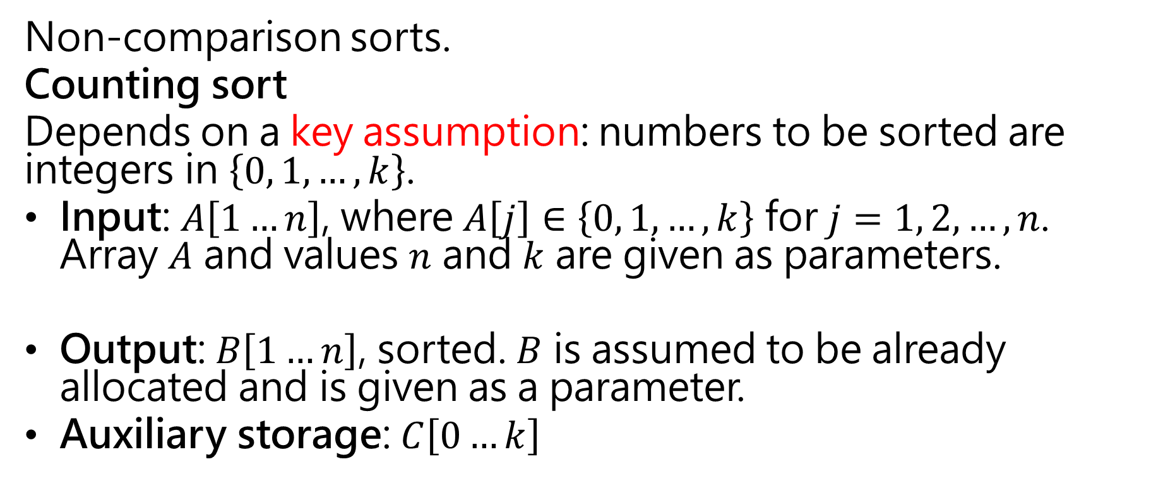
Sorting in linear time
Non-comparison sorts.
Counting sort
Depends on a key assumption: numbers to be sorted are integers in $\left\{0, 1, …, k\right\}$.
Input: $A\left[1…n\right]$, where $A\left[j\right]∈\left\{0, 1, …, k\right\}$ for $j=1, 2, …, n$. Array $A$ and values $n$ and $k$ are given as parameters.
Output: $B\left[1…n\right]$, sorted. $B$ is assumed to be already allocated and is given as a parameter.
Auxiliary storage: $C\left[0…k\right]$

Slide 27
$C\left[i\right]$ now contains the number of elements equal to $i$
$C\left[i\right]$ now contains the number of elements less than or equal to $i$

Slide 28

Do an example for $A=2_{1},5_{1},3_{1},0_{1},2_{2},3_{2},0_{2},3_{3}$
Counting sort is stable (keys with same value appear in same order in output as they did in input) because of how the last loop works.

Slide 29

The operation of Counting-sort on an input array $A\left[1…8\right]$

Slide 30
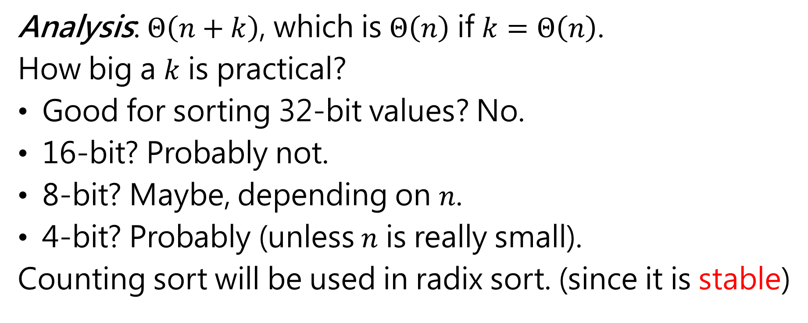
Analysis: $Θ\left(n+k\right)$, which is $Θ\left(n\right)$ if $k=Θ\left(n\right)$.
How big a $k$ is practical?
Good for sorting 32-bit values? No.
16-bit? Probably not.
8-bit? Maybe, depending on $n$.
4-bit? Probably (unless $n$ is really small).
Counting sort will be used in radix sort. (since it is stable)

Slide 31

Radix sort
Key idea: Sort least significant digits first.
To sort $d$ digits:

Slide 33
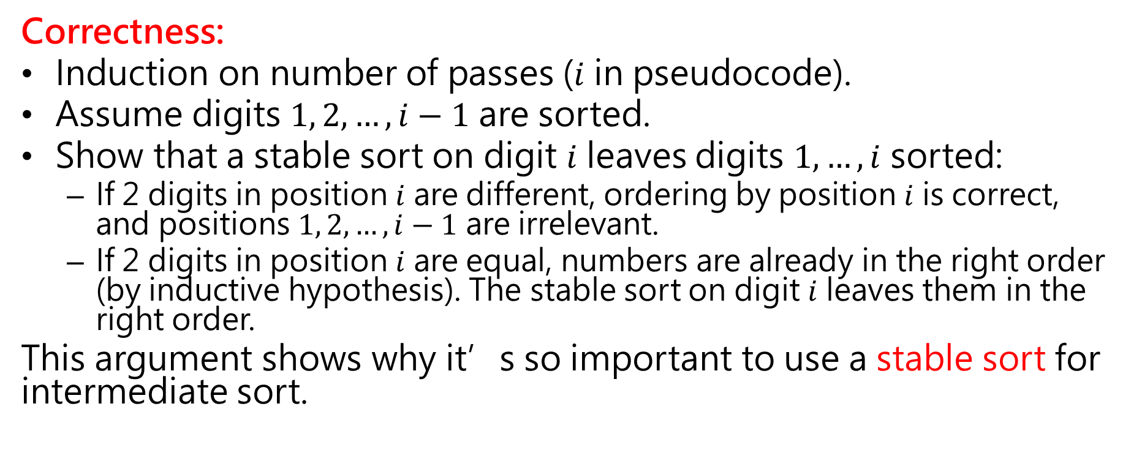
Correctness:
Induction on number of passes ($i$ in pseudocode).
Assume digits $1, 2, …, i−1$ are sorted.
Show that a stable sort on digit $i$ leaves digits $1, …, i$ sorted:
If 2 digits in position $i$ are different, ordering by position $i$ is correct, and positions $1, 2, …, i−1$ are irrelevant.
If 2 digits in position $i$ are equal, numbers are already in the right order (by inductive hypothesis). The stable sort on digit $i$ leaves them in the right order.
This argument shows why it’s so important to use a stable sort for intermediate sort.

Slide 34
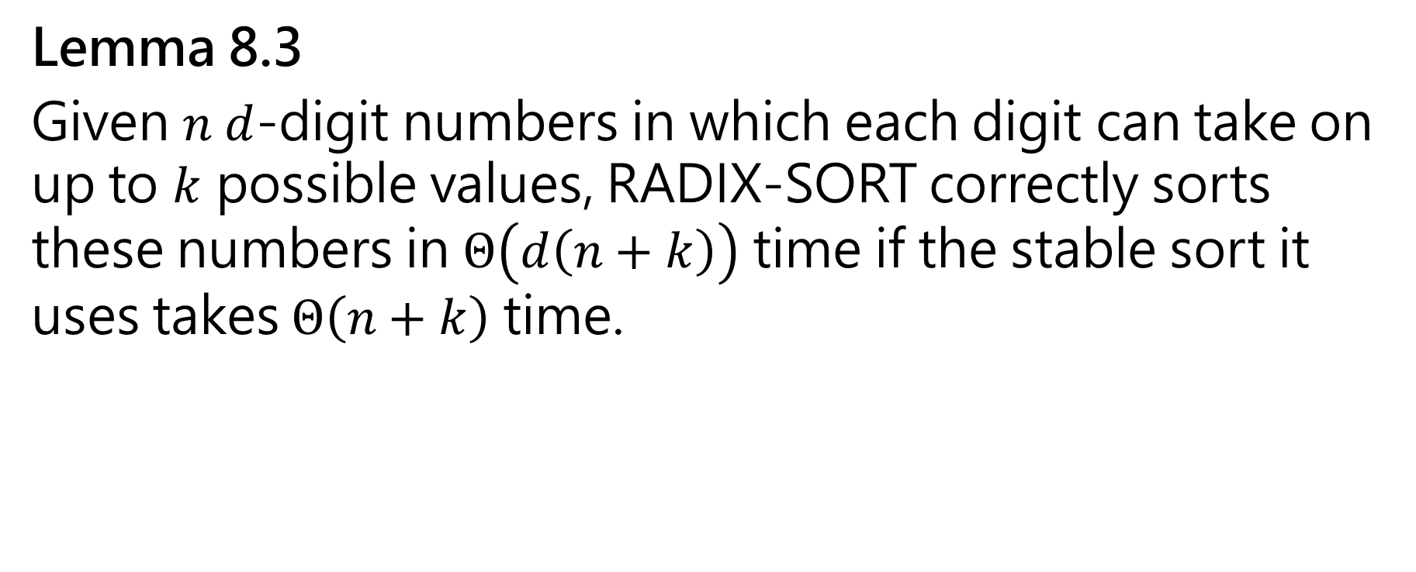
Lemma 8.3
Given $n d$-digit numbers in which each digit can take on up to $k$ possible values, RADIX-SORT correctly sorts these numbers in $Θ\left(d\left(n+k\right)\right)$ time if the stable sort it uses takes $Θ\left(n+k\right)$ time.

Slide 35
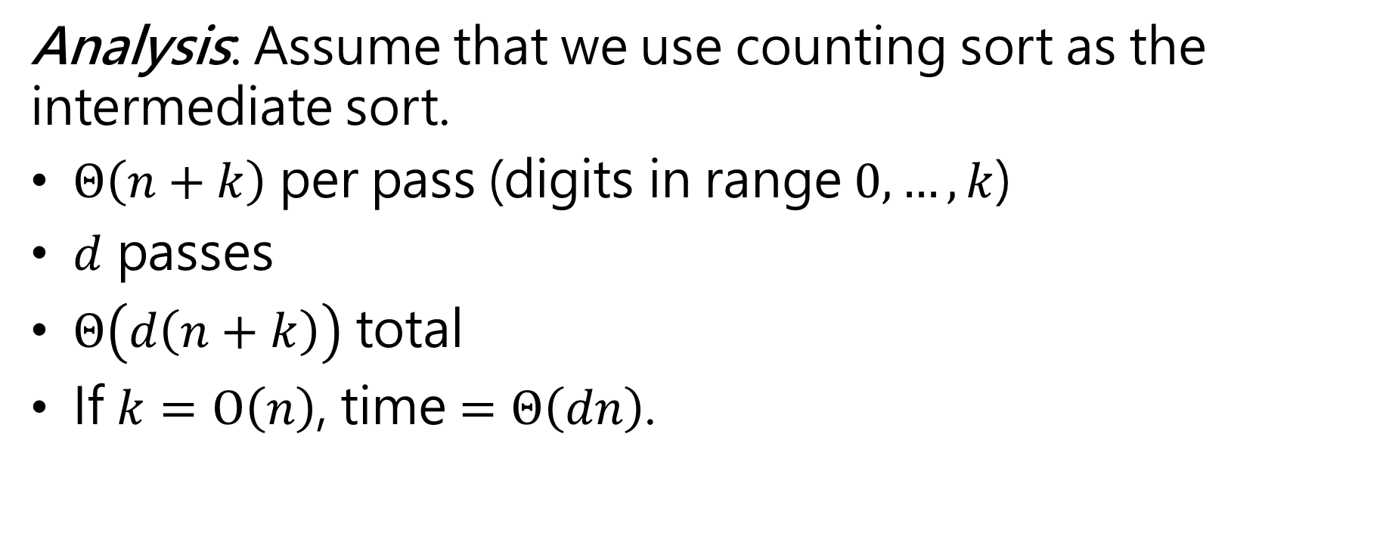
Analysis: Assume that we use counting sort as the intermediate sort.
$Θ\left(n+k\right)$ per pass (digits in range $0, …, k$)
$d$ passes
$Θ\left(d\left(n+k\right)\right)$ total
If $k=O\left(n\right)$, time $=Θ\left(dn\right)$.

Slide 36
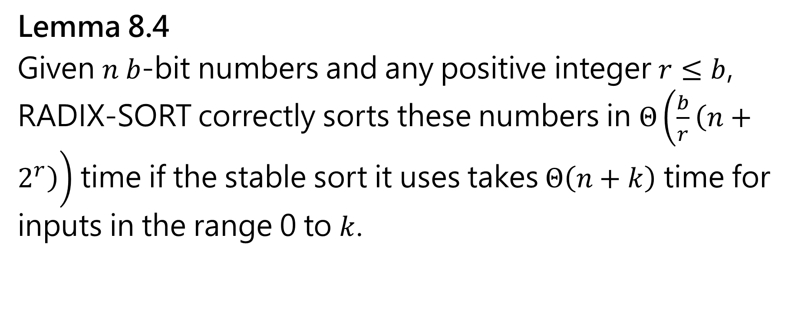
Lemma 8.4
Given $n b$-bit numbers and any positive integer $r≤b$, RADIX-SORT correctly sorts these numbers in $Θ\left(\frac{b}{r}\left(n+2^{r}\right)\right)$ time if the stable sort it uses takes $Θ\left(n+k\right)$ time for inputs in the range 0 to $k$.

Slide 37
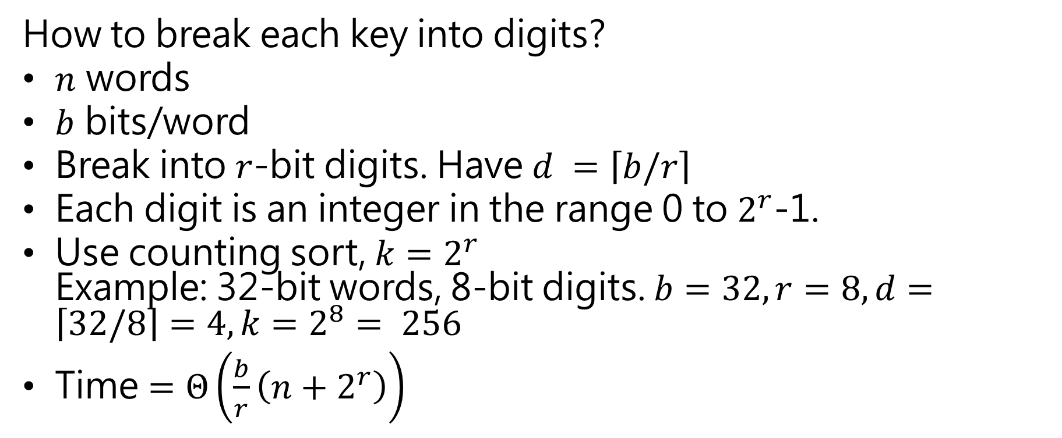
How to break each key into digits?
$n$ words
$b$ bits/word
Break into $r$-bit digits. Have $d =\left\lceil b/r\right\rceil$
Each digit is an integer in the range 0 to $2^{r}$-1.
Use counting sort, $k=2^{r}$ Example: 32-bit words, 8-bit digits. $b=32, r=8, d=\left\lceil 32/8\right\rceil =4, k=2^{8}= 256$
Time $=Θ\left(\frac{b}{r}\left(n+2^{r}\right)\right)$

Slide 38
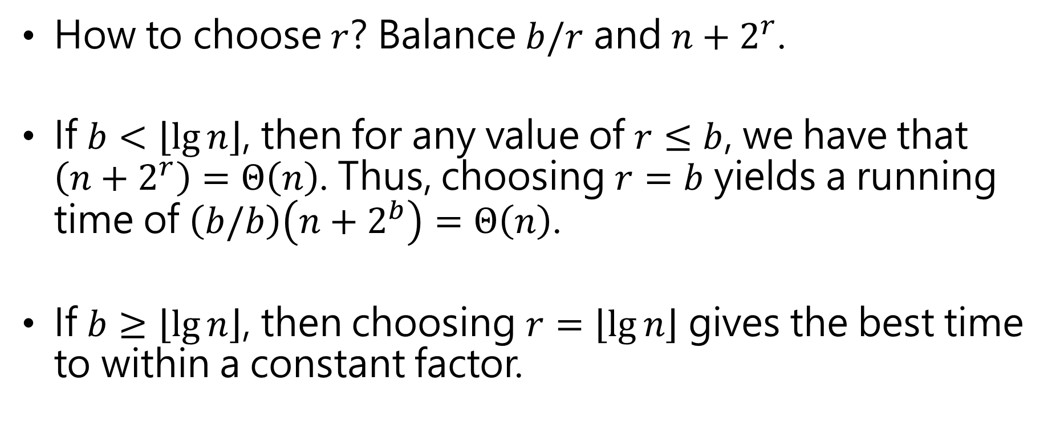
How to choose $r$? Balance $b/r$ and $n+2^{r}$.
If $b<\left\lfloor \lg{n}\right\rfloor$, then for any value of $r≤b$, we have that $\left(n+2^{r}\right)=Θ\left(n\right)$. Thus, choosing $r=b$ yields a running time of $\left(b/b\right)\left(n+2^{b}\right)=Θ\left(n\right)\text{.}$
If $b≥\left\lfloor \lg{n}\right\rfloor$, then choosing $r=\left\lfloor \lg{n}\right\rfloor$ gives the best time to within a constant factor.

Slide 39
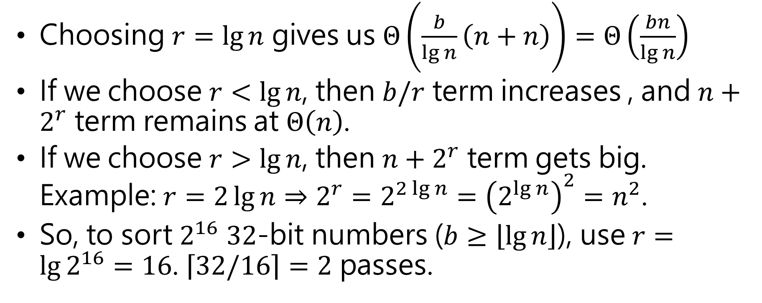
Choosing $r=\lg{n}$ gives us $Θ\left(\frac{b}{\lg{n}}\left(n+n\right)\right)=Θ\left(\frac{bn}{\lg{n}}\right)$
If we choose $r<\lg{n}$, then $b/r$ term increases , and $n+2^{r}$ term remains at $Θ\left(n\right)$.
If we choose $r>\lg{n}$, then $n+2^{r}$ term gets big. Example: $r=2\lg{n}⇒2^{r}=2^{2\lg{n}}={\left(2^{\lg{n}}\right)}^{2}=n^{2}$.
So, to sort $2^{16}$ $32$-bit numbers ($b≥\left\lfloor \lg{n}\right\rfloor$), use $r=\lg{2^{16}}=16$. $\left\lceil 32/16\right\rceil =2$ passes.

Slide 40
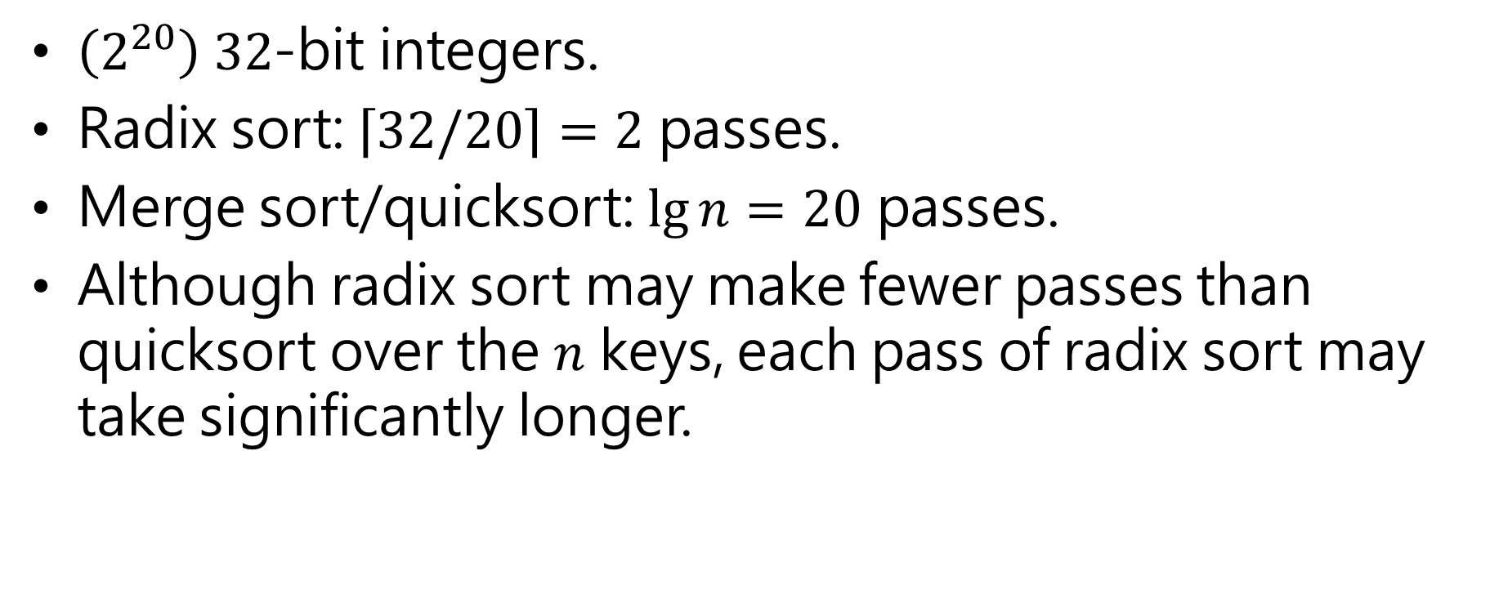
Compare radix sort to merge sort and quicksort:
$\left(2^{20}\right) 32$-bit integers.
Radix sort: $\left\lceil 32/20\right\rceil =2$ passes.
Merge sort/quicksort: $\lg{n=20}$ passes.
Although radix sort may make fewer passes than quicksort over the $n$ keys, each pass of radix sort may take significantly longer.

Slide 41
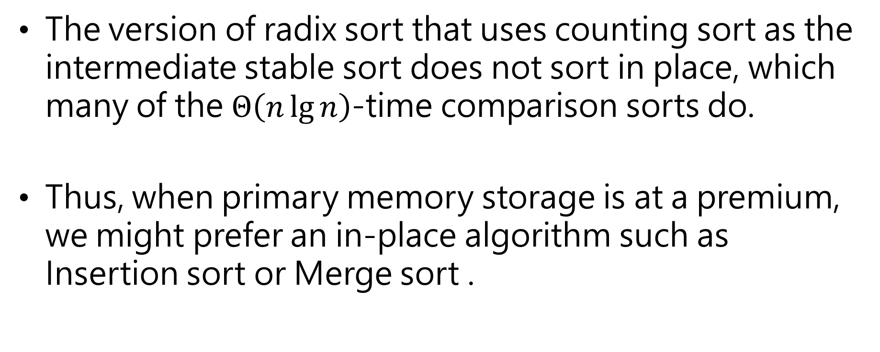
The version of radix sort that uses counting sort as the intermediate stable sort does not sort in place, which many of the $Θ\left(n\lg{n}\right)$-time comparison sorts do.
Thus, when primary memory storage is at a premium, we might prefer an in-place algorithm such as Insertion sort or Merge sort .

Slide 42
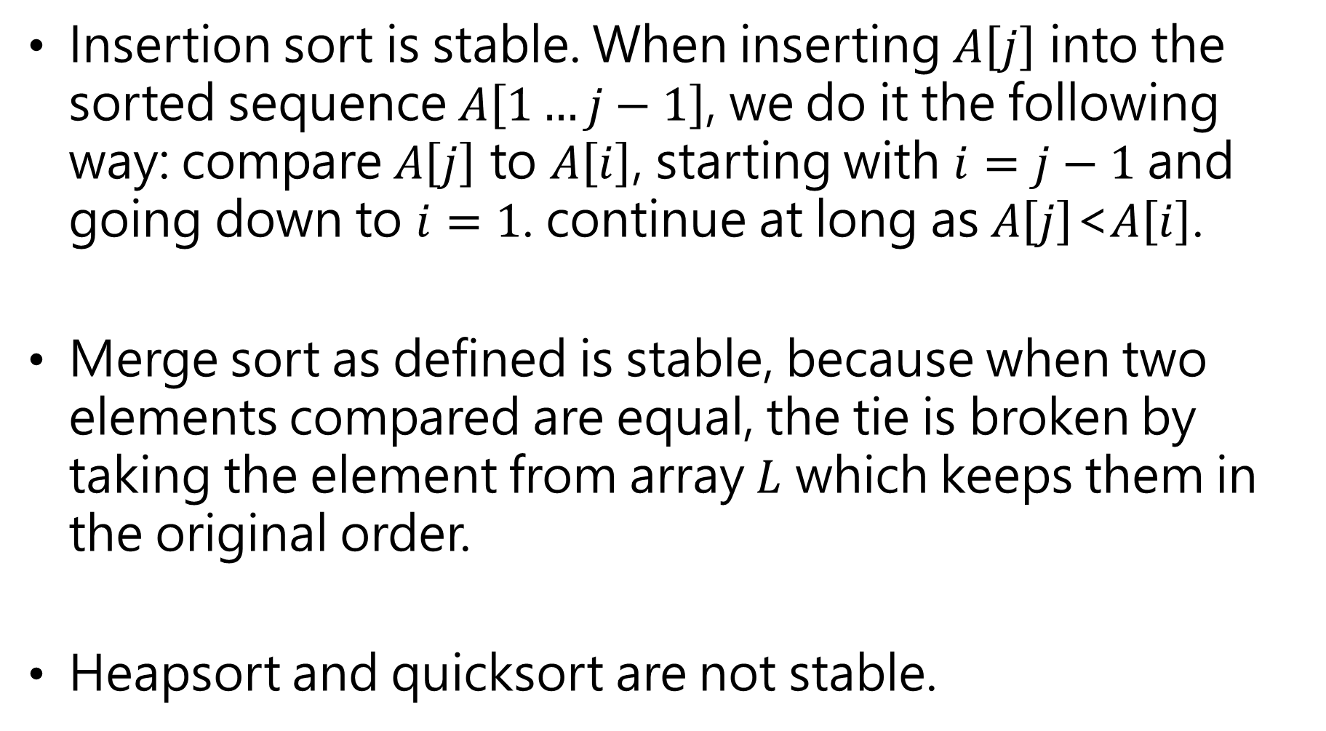
Insertion sort is stable. When inserting $A\left[j\right]$ into the sorted sequence $A\left[1…j−1\right]$, we do it the following way: compare $A\left[j\right]$ to $A\left[i\right]$, starting with $i=j−1$ and going down to $i=1$. continue at long as $A\left[j\right]$<$A\left[i\right]$.
Merge sort as defined is stable, because when two elements compared are equal, the tie is broken by taking the element from array $L$ which keeps them in the original order.
Heapsort and quicksort are not stable.

Slide 43
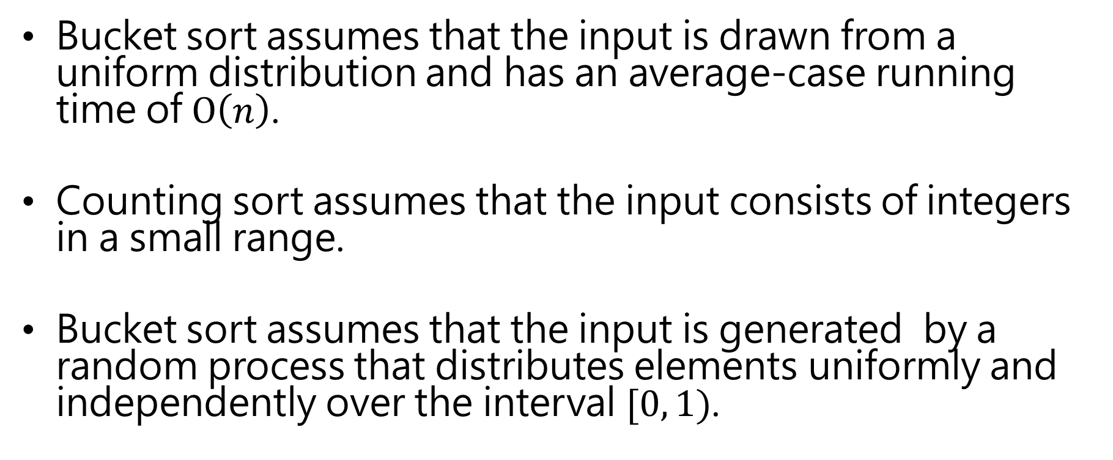
Bucket sort
Bucket sort assumes that the input is drawn from a uniform distribution and has an average-case running time of $O\left(n\right)$.
Counting sort assumes that the input consists of integers in a small range.
Bucket sort assumes that the input is generated by a random process that distributes elements uniformly and independently over the interval $[0, 1)$.

Slide 44
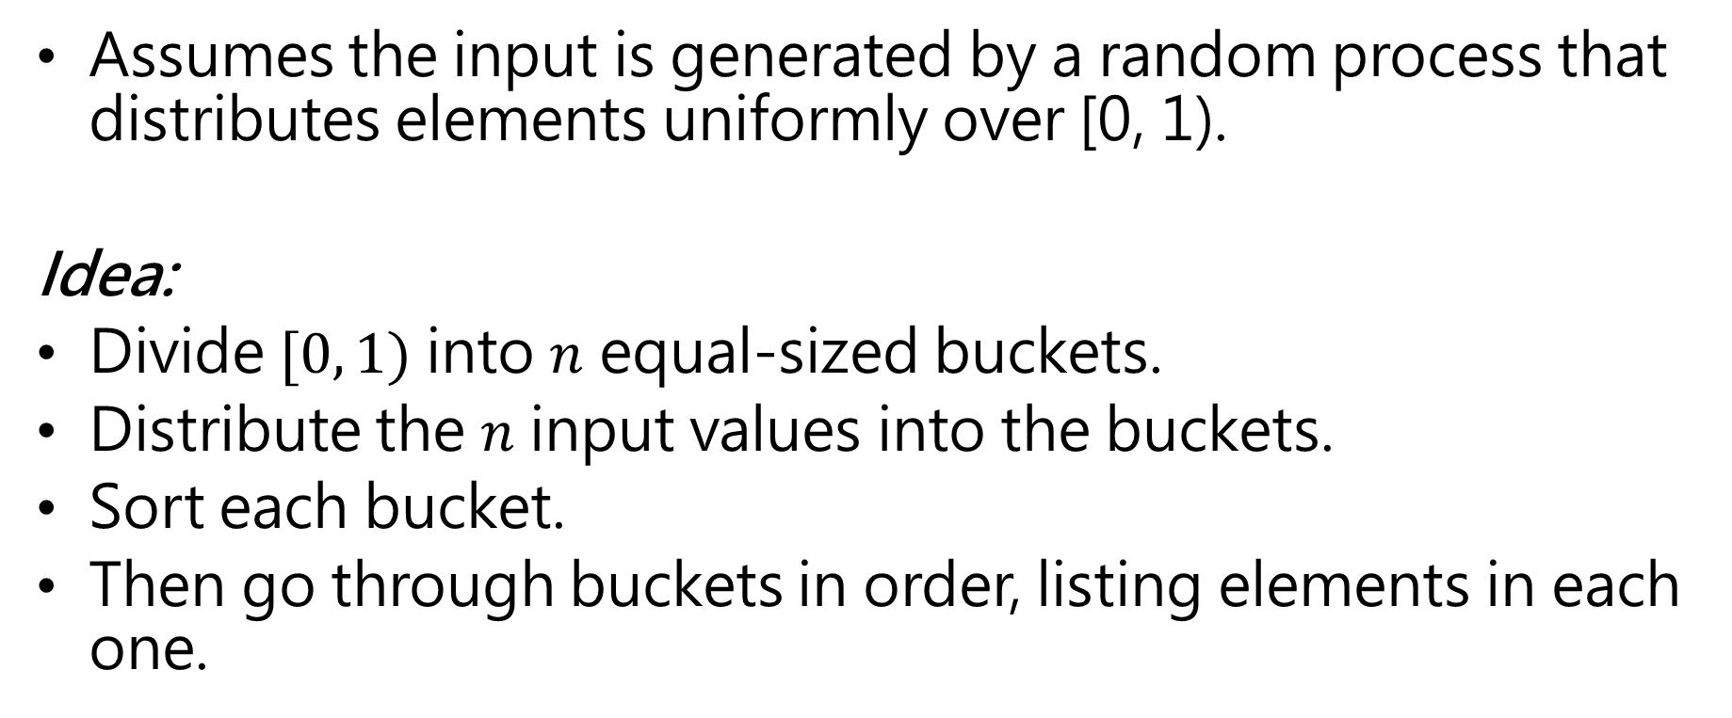
Bucket sort
Assumes the input is generated by a random process that distributes elements uniformly over [0, 1).
Idea:
Divide $[0, 1)$ into $n$ equal-sized buckets.
Distribute the $n$ input values into the buckets.
Sort each bucket.
Then go through buckets in order, listing elements in each one.

Slide 45
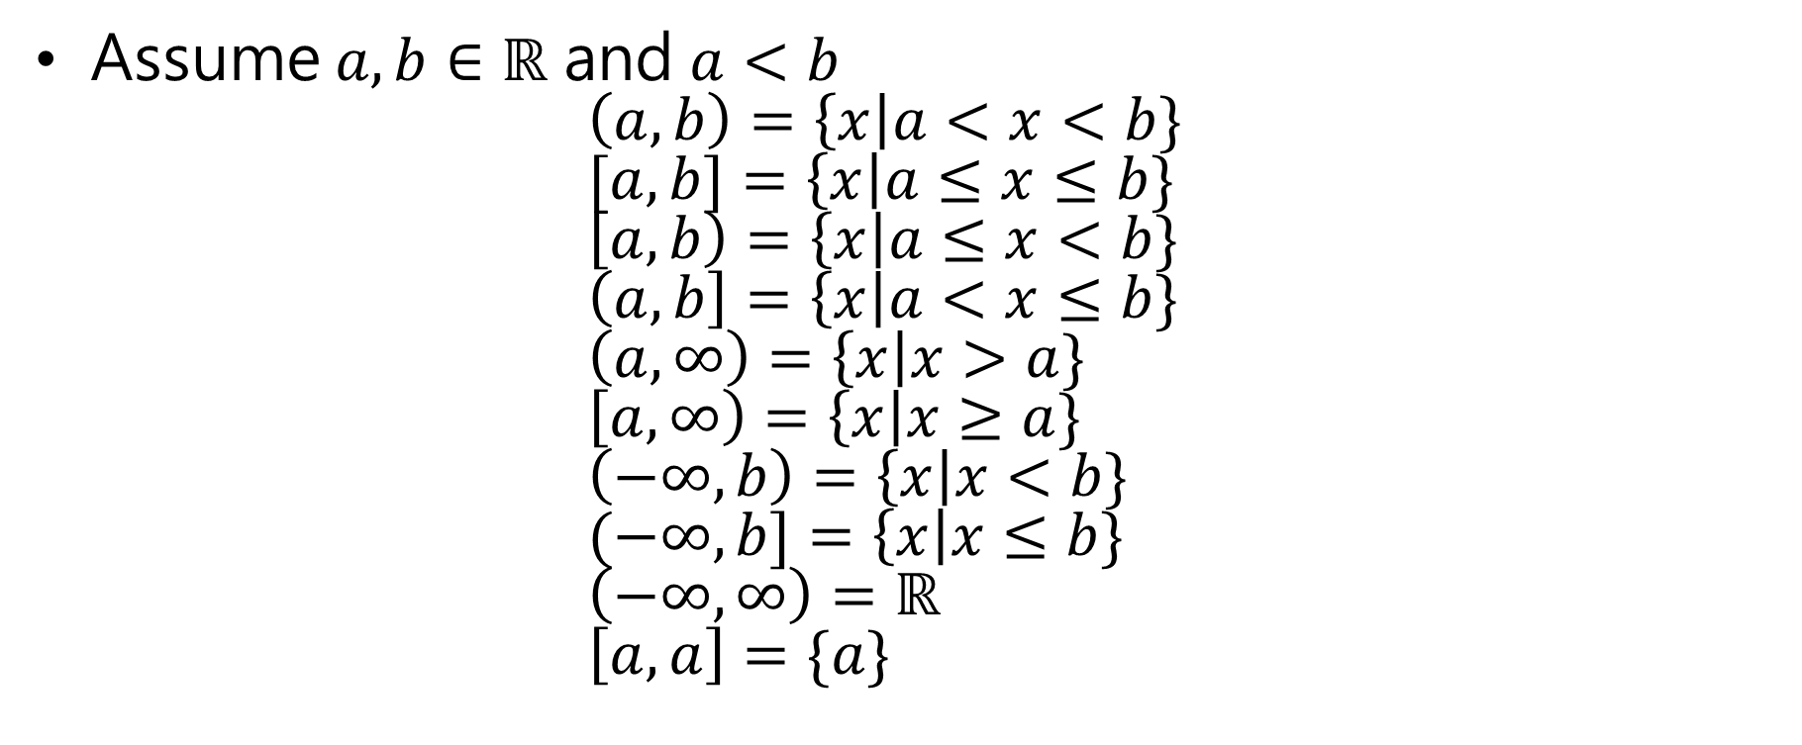
Assume $a,b∈ℝ$ and $a<b$ $\left(a,b\right)=\left\{x\right|a<x<b\}$ $[a,b]=\left\{x\right|a≤x≤b\}$ $\left[a,b\right)=\left\{x\right|a≤x<b\}$ $\left(a,b\right]=\left\{x\right|a<x≤b\}$ $\left(a,∞\right)=\left\{x\right|x>a\}$ $\left[a,∞\right)=\left\{x\right|x≥a\}$ $\left(−∞,b\right)=\left\{x\right|x<b\}$ $(−∞,b]=\left\{x\right|x≤b\}$ $\left(−∞,∞\right)=ℝ$ $\left[a,a\right]=\{a\}$
open interval
closed interval
Left-closed, right-open

Slide 48
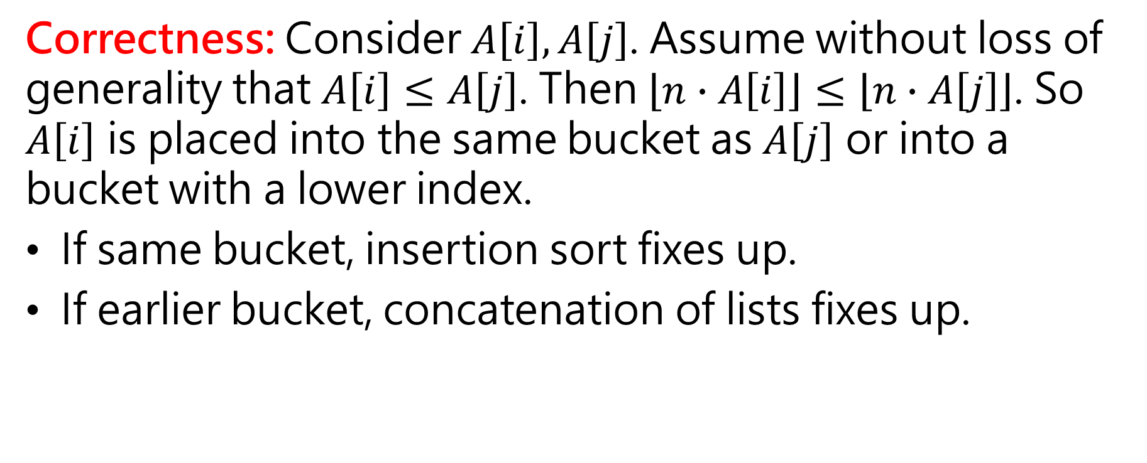
Correctness: Consider $A\left[i\right], A\left[j\right]$. Assume without loss of generality that $A\left[i\right]≤A\left[j\right]$. Then $\left\lfloor n∙A\left[i\right]\right\rfloor ≤\left\lfloor n∙A\left[j\right]\right\rfloor$. So $A\left[i\right]$ is placed into the same bucket as $A\left[j\right]$ or into a bucket with a lower index.
If same bucket, insertion sort fixes up.
If earlier bucket, concatenation of lists fixes up.

Slide 49
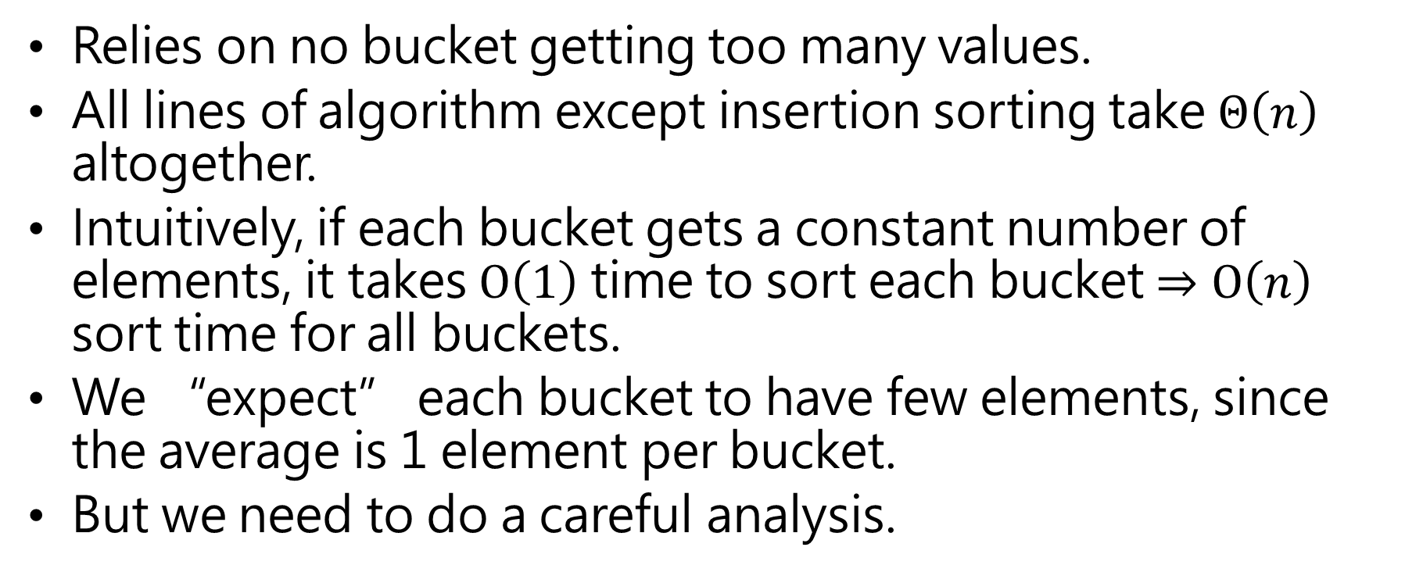
Analysis:
Relies on no bucket getting too many values.
All lines of algorithm except insertion sorting take $Θ\left(n\right)$ altogether.
Intuitively, if each bucket gets a constant number of elements, it takes $O\left(1\right)$ time to sort each bucket $⇒O\left(n\right)$ sort time for all buckets.
We “expect” each bucket to have few elements, since the average is 1 element per bucket.
But we need to do a careful analysis.

Slide 50
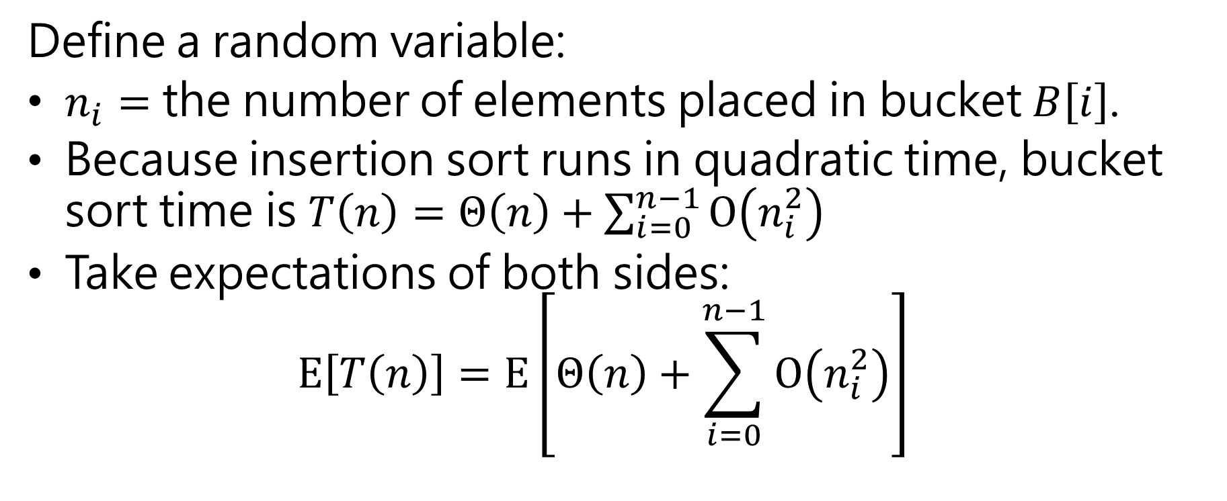
Analysis insertion sort
Define a random variable:
$n_{i}=$ the number of elements placed in bucket $B\left[i\right]$.
Because insertion sort runs in quadratic time, bucket sort time is $T\left(n\right)=Θ\left(n\right)+\sum_{i=0}^{n−1}{O\left(n_{i}^{2}\right)}$
Take expectations of both sides: $E\left[T\left(n\right)\right]=E\left[Θ\left(n\right)+\sum_{i=0}^{n−1}{O\left(n_{i}^{2}\right)}\right]$

Slide 51

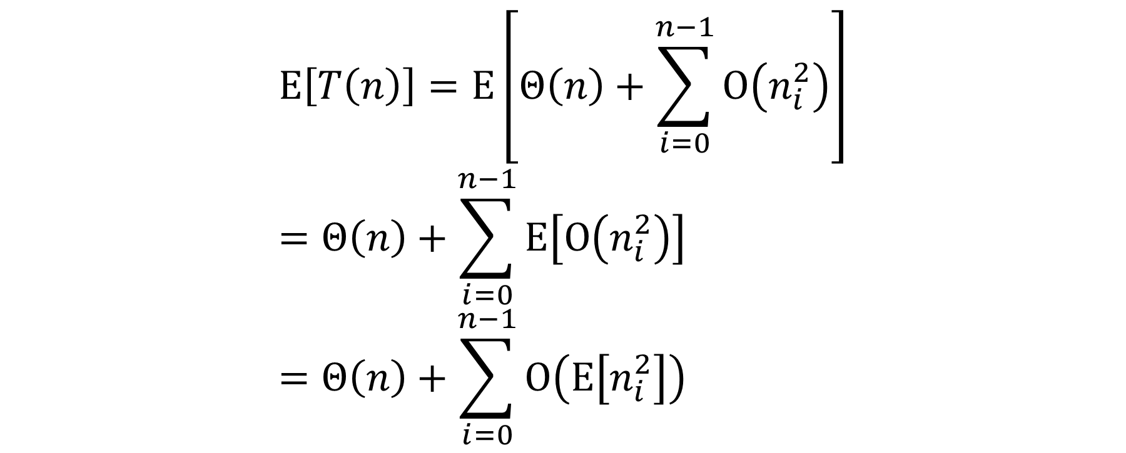
$$E\left[T\left(n\right)\right]=E\left[Θ\left(n\right)+\sum_{i=0}^{n−1}{O\left(n_{i}^{2}\right)}\right] \\ =Θ\left(n\right)+\sum_{i=0}^{n−1}{E\left[O\left(n_{i}^{2}\right)\right]} \\ =Θ\left(n\right)+\sum_{i=0}^{n−1}{O\left(E\left[n_{i}^{2}\right]\right)}$$
(Linearity of expectation)
$$\left(E\left[aX\right]=aE\left[X\right]\right)$$

Slide 52
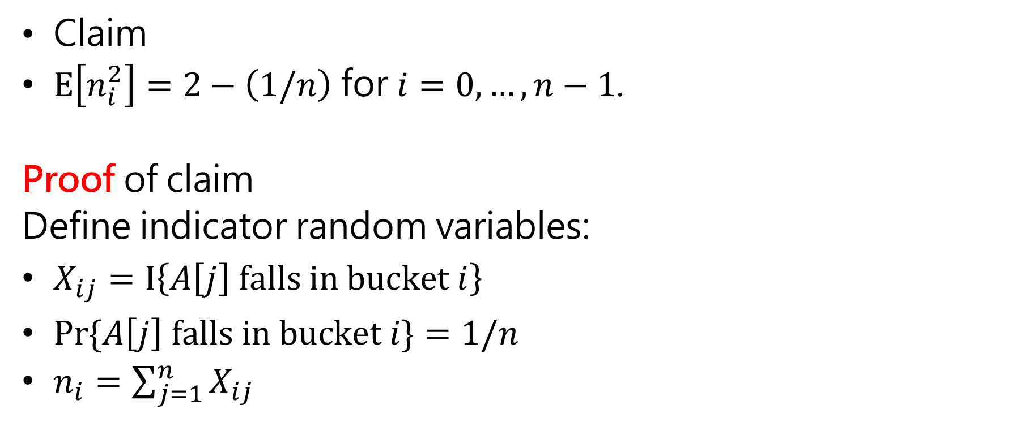
Claim
$E\left[n_{i}^{2}\right]=2−\left(1/n\right)$ for $i=0, …, n−1$.
Proof of claim
Define indicator random variables:
$X_{ij}=I\left\{A\left[j\right] falls in bucket i\right\}$
$Pr⁡\{A\left[j\right] falls in bucket i\}=1/n$
$n_{i}=\sum_{j=1}^{n}{X_{ij}}$

Slide 53

Then
$$E\left[n_{i}^{2}\right]=E\left[{\left(\sum_{j=1}^{n}{X_{ij}}\right)}^{2}\right] \\ =E\left[\sum_{j=1}^{n}{X_{ij}^{2}}+2\sum_{j=1}^{n−1}{\sum_{k=j+1}^{n}{X_{ij}X_{ik}}}\right] \\ =\sum_{j=1}^{n}{E\left[X_{ij}^{2}\right]}+2\sum_{j=1}^{n−1}{\sum_{k=j+1}^{n}{E\left[X_{ij}X_{ik}\right]}}$$

Slide 54

$$E\left[X_{ij}^{2}\right]=0^{2}∙\operatorname{Pr}\left\{A\left[j\right] {doesn}^{′}t fall in bucket i\right\}+1^{2}∙\operatorname{Pr}\left\{A\left[j\right] falls in bucket i\right\} \\ =0∙\left(1−\frac{1}{n}\right)+1∙\frac{1}{n} \\ =\frac{1}{n}$$

Slide 55

$E\left[X_{ij}X_{ik}\right]$for $j≠k$: Since $j≠k$, $X_{ij}$ and $X_{ik}$ are independent random variables
$⇒E\left[X_{ij}X_{ik}\right]=E\left[X_{ij}\right]$ $E\left[X_{ik}\right]=\frac{1}{n}∙\frac{1}{n}=\frac{1}{n^{2}}$

Slide 56

Therefore:
$$E\left[n_{i}^{2}\right]=\sum_{j=1}^{n}{E\left[X_{ij}^{2}\right]}+2\sum_{j=1}^{n−1}{\sum_{k=j+1}^{n}{E\left[X_{ij}X_{ik}\right]}} \\ =\sum_{j=1}^{n}{\frac{1}{n}}+2\sum_{j=1}^{n−1}{\sum_{k=j+1}^{n}{\frac{1}{n^{2}}}} \\ =n∙\frac{1}{n}+2\left({n \atop 2}\right)\frac{1}{n^{2}} \\ =1+2\frac{n!}{2!\left(n−2\right)!}\frac{1}{n^{2}} \\ =1+\frac{n−1}{n} \\ =1+1−\frac{1}{n} \\ =2−\frac{1}{n}$$
■

Slide 57

Therefore:
$$E\left[T\left(n\right)\right]=Θ\left(n\right)+\sum_{i=0}^{n−1}{O\left(E\left[n_{i}^{2}\right]\right)} \\ =Θ\left(n\right)+\sum_{i=0}^{n−1}{O\left(2−\frac{1}{n}\right)} \\ =Θ\left(n\right)+O\left(n\right) \\ =Θ\left(n\right)$$

Slide 58
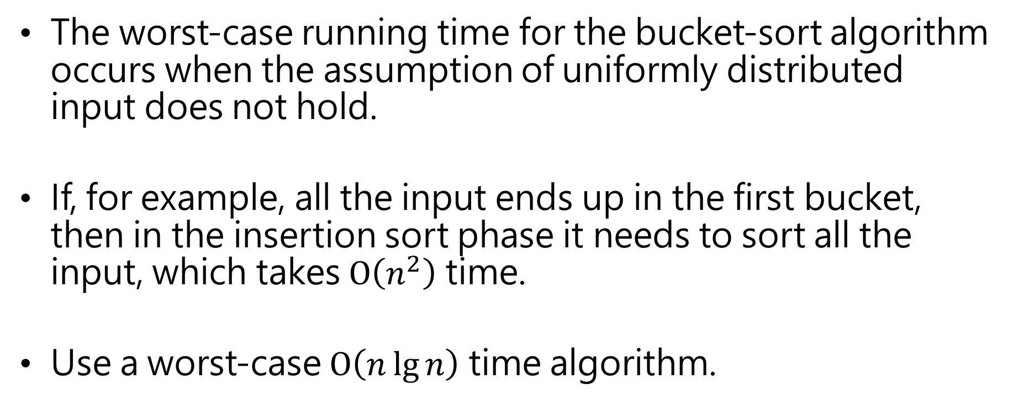
The worst-case running time for the bucket-sort algorithm occurs when the assumption of uniformly distributed input does not hold.
If, for example, all the input ends up in the first bucket, then in the insertion sort phase it needs to sort all the input, which takes $O\left(n^{2}\right)$ time.
Use a worst-case $O\left(n\lg{n}\right)$ time algorithm.

Slide 59
Again, not a comparison sort. Used a function of key values to index into an array.
This is a probabilistic analysis—we used probability to analyze an algorithm whose running time depends on the distribution of inputs.

Slide 60
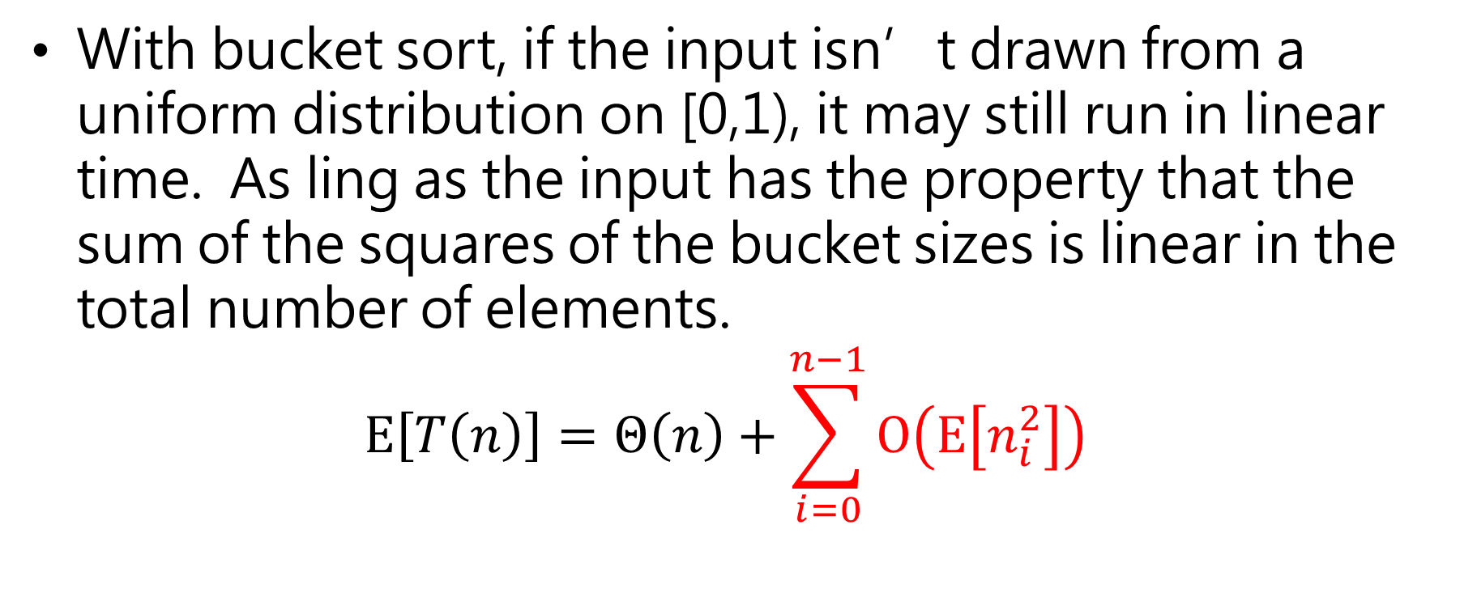
With bucket sort, if the input isn’t drawn from a uniform distribution on [0,1), it may still run in linear time. As ling as the input has the property that the sum of the squares of the bucket sizes is linear in the total number of elements. $E\left[T\left(n\right)\right]=Θ\left(n\right)+\sum_{i=0}^{n−1}{O\left(E\left[n_{i}^{2}\right]\right)}$

